Slide 1

Credit Card Fraud Detection
Eliott Hangard
Thibaud Rimbert
Arsène Galliez
Hugo Dos-anjos-dos-santos
Notes:
Eliott

Slide 2
Table of contents
INTRODUCTION & CONTEXT
EXPLORATORY DATA ANALYSIS
METHODOLOGY & MODELS
RESULTS & CONCLUSION
Notes:
Eliott

Slide 3
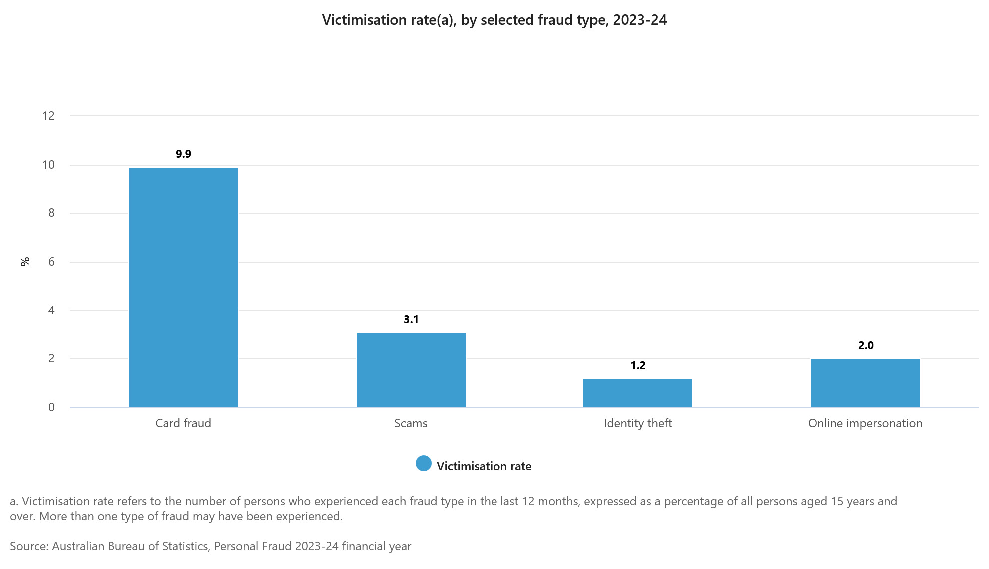
Fraudulent Transactions - Scale of the Problem
Worldwide gross card fraud losses reached $33.83 billion in 2023 [Nilson Report, 2024].
More than half of scam victims consider switching financial institutions after their experience, and 30% actually do so [PYMNTS, 2024].
Notes:
Thibaud

Slide 4
Benefits of Machine Learning for Fraud Detection
Seven in 10 banking executives say AI will be the most critical technology over the next decade for fraud prevention [Laura Fitzgerald, 2024].
Machine learning systems can handle billions of transactions and respond in real-time with accuracy, computing risk scores during transactional events in less than 100 milliseconds [Fraud.com].
Machine learning systems never stop learning and can detect new fraud scenarios and patterns quickly and accurately, helping organizations stay up to date with evolving threats [Fraud.com].
Notes:
Thibaud

Slide 5

Presentation of the dataset
Note: All numeric · already clean (no missing values)
Source: Kaggle “Credit Card Fraud Detection”
Scope: 284 807 transactions · 2 days (Sept 2013)
Features: 31 total → 28 PCA-anonymized + Time + Amount + Class
Class: 0 = legitimate · 1 = fraud
Notes:
The dataset we used comes from Kaggle, published by MLG-ULB, and it contains around 284 000 transactions made by European cardholders over a two-day period in September 2013. Each transaction is described by 31 features: 28 of them are anonymized using a PCA transformation for confidentiality reasons, and only three are known — the transaction time, the amount, and the class label, which indicates whether the transaction is fraudulent (1) or legitimate (0). The data are already cleaned and numeric, which made preprocessing simpler, but their anonymity means we must rely on the statistical behavior of the features rather than their semantic meaning.

Slide 6
Class imbalance & performance objectives
This extreme class imbalance makes fraud detection challenging :
A model could simply predict “no fraud” all the time and still achieve high accuracy but miss almost all fraud cases.
That’s why our performance focus was not on accuracy, but on :
Maximizing Recall → catching as many fraudulent transactions as possible (minimizing false negatives).
Maintaining acceptable accuracy → to reduce the number of false alarms..
⚠️ This is critical in real-world banking: missing a fraudulent transaction is much more costly than flagging a legitimate one.
In our dataset, there are 284,807 transactions, but only 492 are fraudulent, which is just 0.172%
Using AUC-ROC as a key overall metric.
Notes:
Our dataset has almost 285 thousand transactions, but only 492 are fraudulent that’s just 0.172 percent.
This class imbalance is a real challenge. If a model only predicts ‘no fraud,’ it would still get high accuracy but miss almost all fraud cases.
That’s why our goal was to maximize recall to catch as many fraudulent transactions as possible, keep acurracy at an acceptable level, and use AUC as one of our main metric.
Because it’s better to flag a legitimate transaction than missing a fraudulent one.

Slide 7
EXPLORATORY DATA ANALYSIS

Slide 8
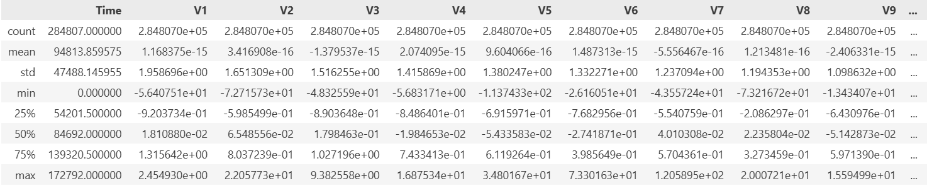
Data Quality Analysis
Notes:
Thibaud

Slide 9
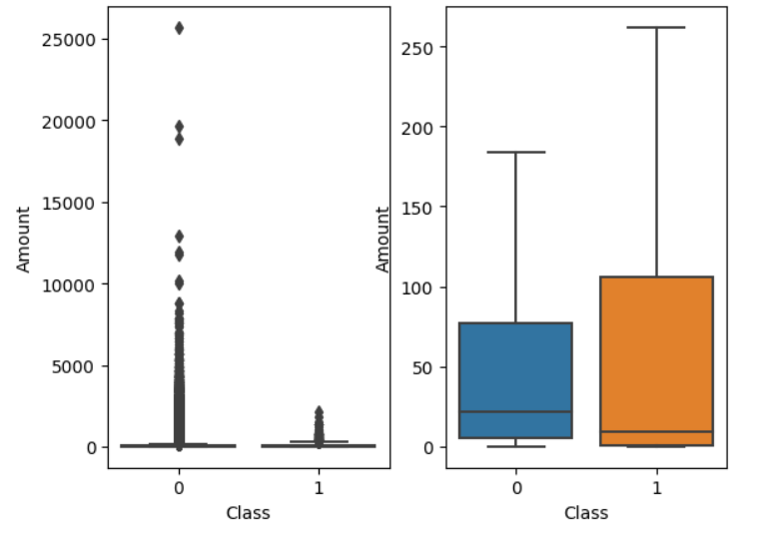
Data Quality Analysis
Amount
 | Normal | Fraudulent
Mean | 88.3 | 122.2
Std | 250.1 | 256.6
Notes:
There is a noticeable difference in the distribution of transaction amounts between fraudulent and normal transactions. The normal transactions have an higher median, a larger Q1 but a smaller Q3 and Q4 and larger outliers.
Fraudulent transactions have a higher average amount compared to normal transactions, indicating that fraudulent activities tend to involve slightly larger sums on average. Both classes exhibit significant variability in transaction amounts. However, fraudulent transactions have a slightly narrower spread relative to their mean. Fraudulent transactions appear to avoid excessively large and unusual amounts of transactions, probably to avoid detection. However, the 75th percentile is much higher, suggesting that fraudulent transactions are more likely to involve moderately high amounts.

Slide 10
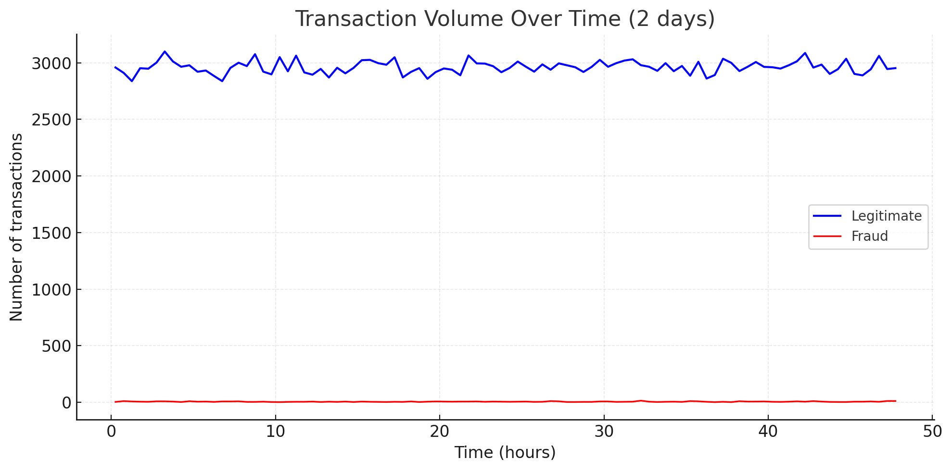
Temporal analysis of transactions and fraud
Implication: detection requires combining multiple features
Timeline: 2 days of transactions
Observation: 2 activity peaks (daytime usage pattern)
Frauds: evenly distributed across time
Insight: time ≠ strong predictor
Notes:
The temporal analysis focuses on how transactions and frauds evolve over time. When plotting the number of transactions against time, we can see two main peaks of activity, which correspond to the two collection days. This reflects typical user behavior — most transactions occur during daytime hours and drop overnight. When we overlay the fraud cases on this timeline, we notice that frauds are evenly distributed; they do not cluster in a specific time window. This shows that time alone is not a strong predictor of fraudulent behavior, and that the models will need to rely on a combination of other features to detect anomalies effectively.

Slide 11
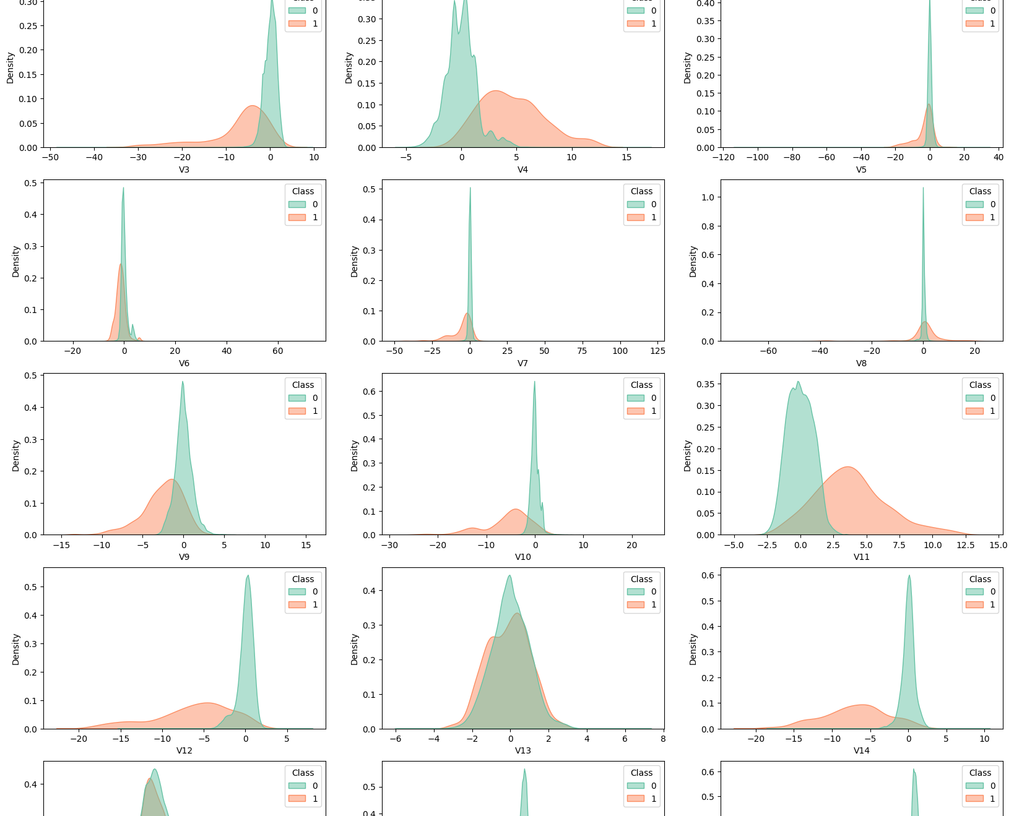
Amount feature & distributions
Amount & Similar Features:
Amount, V13, V15, V22, V24, V25, V26, V28 → Almost identical distributions for both classes.
Low predictive power for classification.
Long-Tailed Features:
V1, V2, V5, V6, V7, V8, V20, V21, V23, V27 → Long tail for class 0, absent in class 1.
Potential for classification, but overlap remains.
Highly Distinct Distributions:
V3, V4, V9, V10, V11, V12, V14, V16, V17, V18 → Different means and larger standard deviations.
Strong candidates for predicting class membership.
Notes:
When analyzing the Amount feature and the distributions of the dataset, we observe that some features are far more useful for classification than others.
First, the Amount feature shows in first categorie nearly identical density plots for both classes. This means they don’t help distinguish between class 0 and class 1, making them less valuable for predictive modeling, like the categorie 2 with the absence in class 1.
On the other hand, features the third categorie stand out. Their distributions are significantly different between the two classes, with distinct means and much larger standard deviations. These differences make them strong candidates for building a classification model, as they provide clear signals to separate the classes effectively.

Slide 12
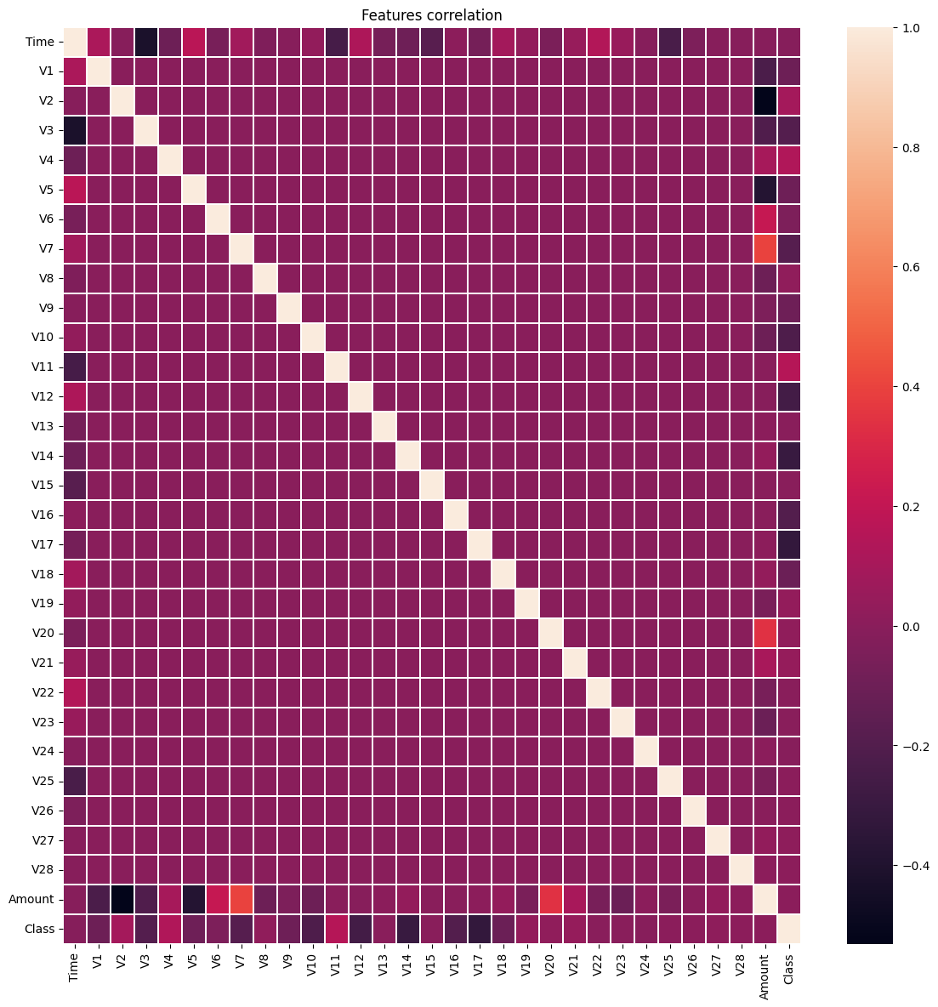
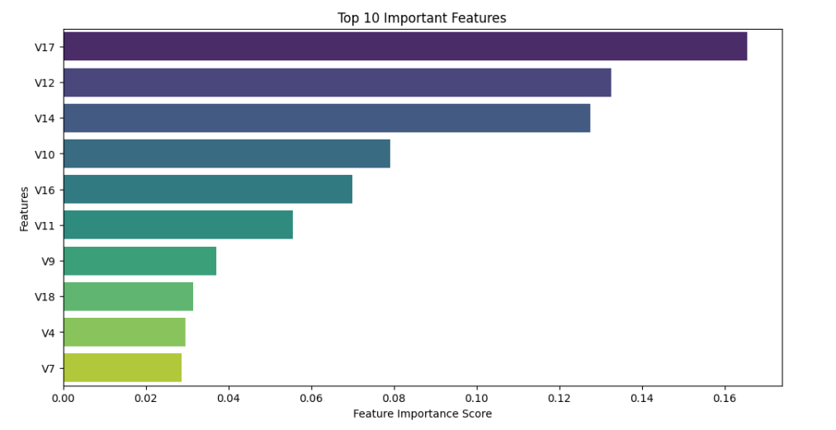
Features correlation
No real correlation
Notes:
Eliott

Slide 13
METHODOLOGY & MODELS
Notes:
In this third part, we will present the methodology used to train our fraud detection models, detailing the data preprocessing steps and the different algorithms we tested.

Slide 14
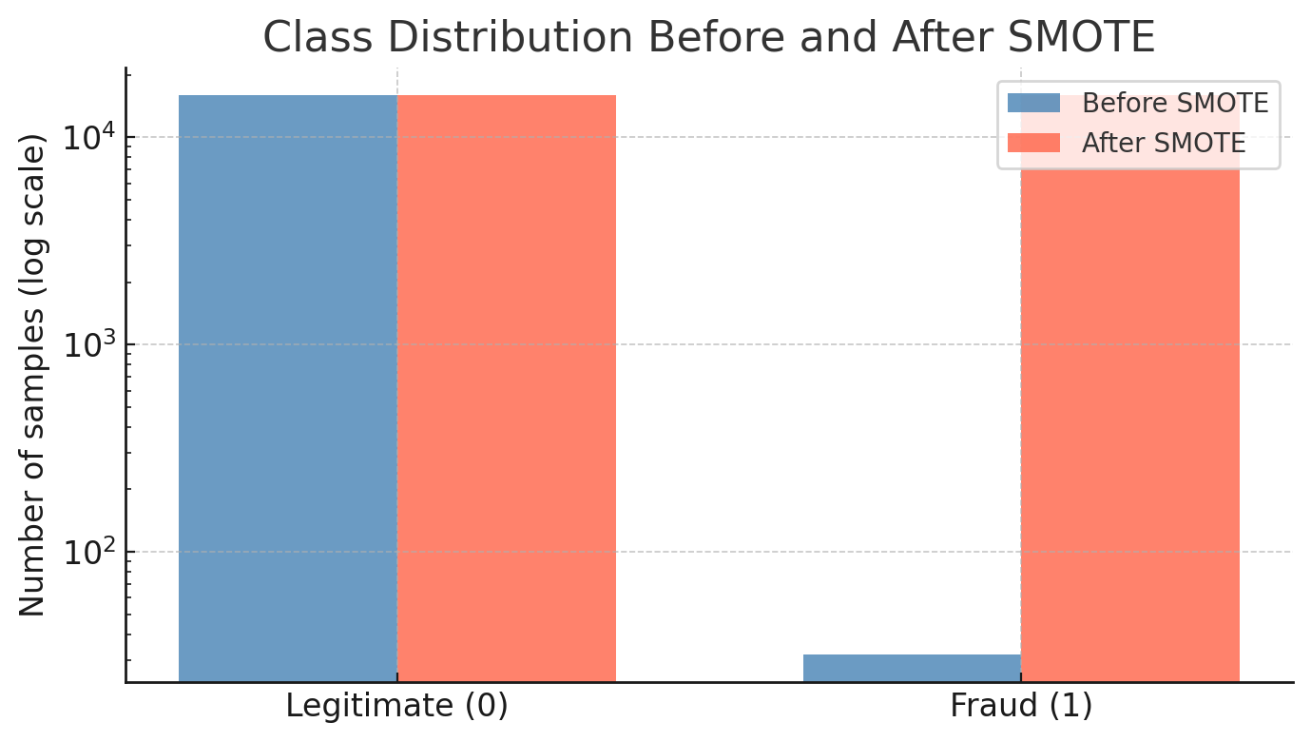
Preparing the Data for Learning
Split: 80 % train · 10 % validation · 10 % test
Scaling: StandardScaler applied on train only
Imbalance: ~0.17 % fraud cases
Solution: oversampling (SMOTE) on train set only
Goal: balanced learning → better fraud recognition
Notes:
Before training the models, the dataset was split into three parts: 80 % for training, 10 % for validation, and 10 % for testing. Then we applied a StandardScaler to normalize all numerical values so that features with large ranges, like the amount, do not dominate the learning process. Because the dataset is highly imbalanced, with only 0.17 % fraud cases, we used an oversampling technique, such as SMOTE, but only on the training set to avoid data leakage. This rebalancing step helped the algorithms better learn the characteristics of fraudulent transactions without biasing the evaluation metrics on the validation and test sets.

Slide 15
Decision Tree & Random Forest (architecture, tuning, results)
🪴Decision Tree
Started with a basic Decision Tree without hyperparameter tuning.
A decent baseline, but the recall was slightly too low for our use case.
Oversampling didn’t improve the results significantly.
→ Conclusion: fast and simple model, but not powerful enough.
Notes:
For the modeling, at the beginning we focused on Decision Tree and Random Forest.
The Decision Tree served as our initial model. We started with a basic implementation, without hyperparameter tuning. While it provided a decent baseline, the recall was slightly too low for our specific use case.
The Decision Tree gave a good baseline but not enough recall for our goal.

Slide 16
Decision Tree & Random Forest (architecture, tuning, results)
🌲 Random Forest
We applied GridSearch on:
n_estimators = [50, 100]
max_depth = [3, 10]
After hyperparameter tuning and threshold adjustment:
Recall = 78 %%
precision = 94%
This model offered a strong balance between detecting fraud and avoiding false positives.
→ It became a solid reference model, though slightly below our 90% recall target.
Notes:
Then we moved to Random Forest, which is more robust.
We applied a GridSearch to tune the hyperparameters, especially the number of estimators and the maximum depth.
n_estimators controls the number of trees.
To improves stability and performance but also increases training time.
max_depth controls how deep each tree can grow. Deeper trees can learn more complex patterns but may overfit the data.
After tuning and adjusting the decision threshold, the model achieved 78 % recall and 94% acurracy. This means it was able to detect most fraudulent transactions while keeping false positives relatively low.

Slide 17
XGBoost model
After a hyperparameter search using GridSearch, the best parameters obtained were:
n_estimators = 200
subsample = 0.5
Parameter | Value | Purpose
scale_pos_weight | 5 | Increases the weight assigned to the minority class, in this case fraud.
random_state | 42 | Allows for reproducible results by setting the random generation seed.
use_label_encoder | False | Disables older label encoding mechanism.
eval_metric | ’logloss’ | Measures the classification error based on predicted probabilities. The lower the logloss, the better the model.
Notes:
Eliott

Slide 18
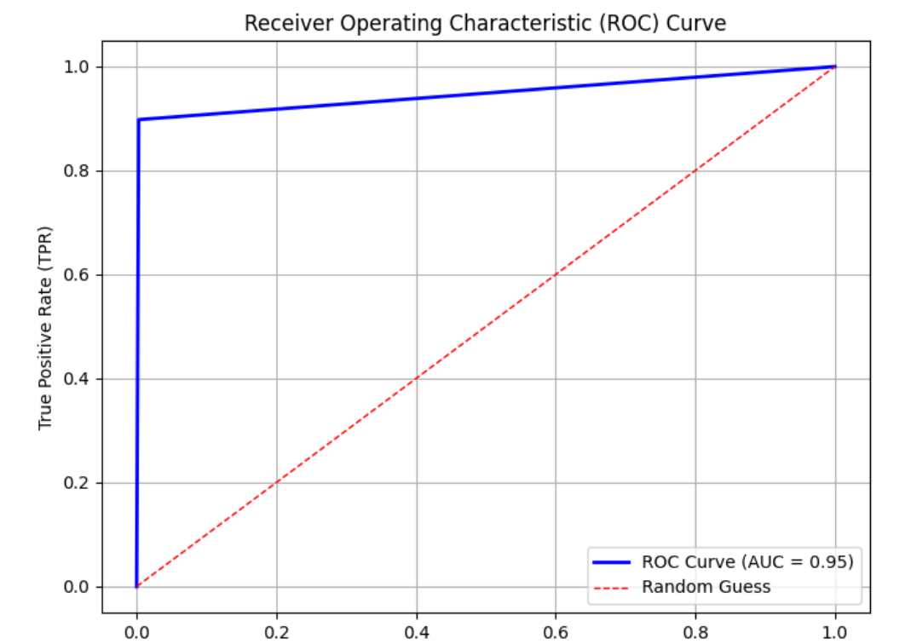
XGBoost model
Actual \ Predicted | Positive | Negative
Positive | 56696 | 168
Negative | 10 | 88
This allowed us to achieve a recall of 90% at the cost of 34% precision.
AUC score of 0.9475
Notes:
Eliott

Slide 19
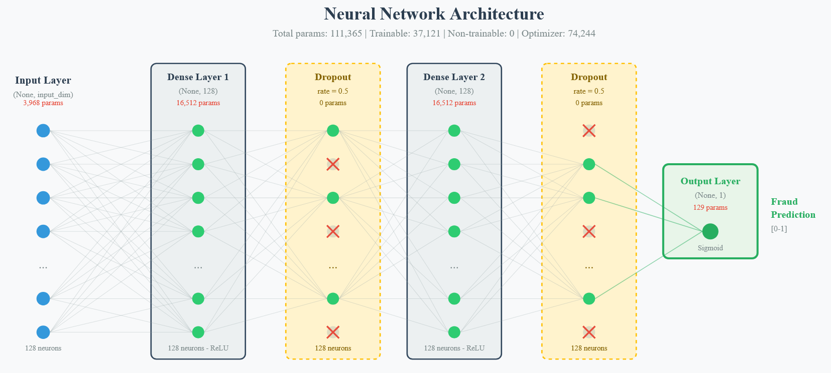
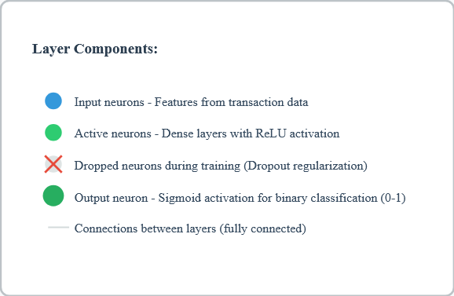
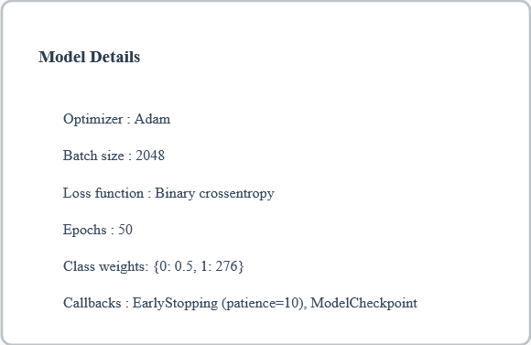
Deep Neural Network – Architecture :
Notes:
Thibaud

Slide 20
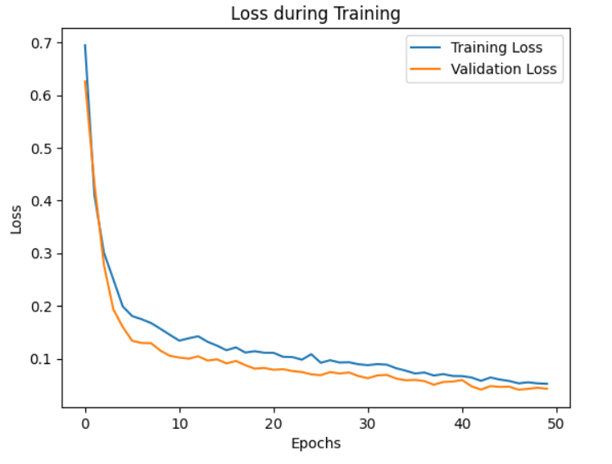
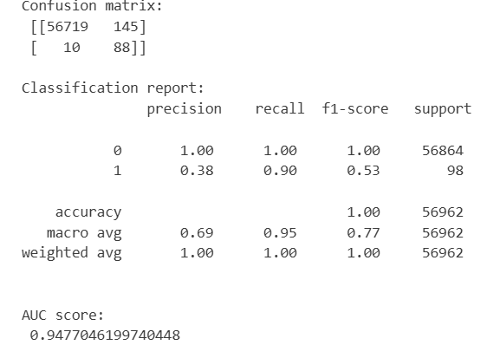
Deep Neural Network – Results :
Notes:
Thibaud

Slide 21
RESULTS & CONCLUSION

Slide 22
Model comparison table (Recall, Accuracy, AUC)
Model | Recall | Precision | AUC | Notes
Decision Tree | 76% | 77% | 0.8773 | Simple, baseline performance
Random Forest | 78 % | 94 % | 0.8877 | Good trade-off
XGBoost | 90 % | 34 % | 0.9475 | Reached recall target through threshold tuning
Deep Neural Network | 90 % | 38 % | 0.9477 | Best overall performance
Notes:
The main criteria for evaluating our models were Recall, accuracy, and AUC, with a strong focus on maximizing Recall to detect as many frauds as possible while the AUC measures how well a model can distinguish between the positive and negative classes.
To continue with a quick comparison: Decision Tree got around 76 percent recall, Random Forest 78 percent, this in not enough for our use case, but XGBoost reached our target of 90 percent recall, and the Deep Neural Network gave the best results with 90% of recall and 0.9477 AUC.
Random Forest provided a better balance between accuracy and recall compared to the Decision Tree, but it still fell short of our target performance of 90% of recall.
but Deep Neural Network showed the best performance overall, even if XGBoost is a good candidate.

Slide 23
Best model : DNN
This model outperformed the others, achieving a recall close to 90% and an AUC of 0.9477 at a precision of 38 %.
Ability to learn complex nonlinear relationships the DNN became our best model for effectively detecting fraud.
Well-calibrated neural network remains the most powerful solution for this type of problem
Notes:
Eliott

Slide 24
Project limitations
Data Limitations :
Severe Class Imbalance
Model Performance Challenges :
acurracy-Recall Trade-off
Computational Constraints
Blackbox models
Anonymized Features (PCA-transformed)
Weak Feature Correlations
Limited Data Temporal Coverage
Notes:
1. Data Limitations
Severe Class Imbalance : Only 0.17% of transactions are fraudulent.
This extreme imbalance makes it difficult for models to learn patterns from fraud cases
Solution attempted: RandomOverSampler for data augmentation, but it actually decreased performance
Anonymized Features (PCA-transformed)
Features V1-V28 are PCA-transformed for privacy. Loss of interpretability: Cannot understand what these features represent
Limitation: Cannot perform feature engineering or domain-specific optimizations
Weak Feature Correlations
Correlations coefficients with the Class feature are very low
Strongest correlations: V17 (-0.33), V14 (-0.30), V12 (-0.26) - still quite weak
2. Model Performance Challenges
acurracy-Recall Trade-offTarget goal: 90% recall with >30% acurracy
High recall means catching more frauds but also flagging legitimate transactions
Outliers Impact
outliers in almost all features
Could negatively affect distance-based or tree-based models
Requires careful preprocessing and scaling
3. Technical Difficulties
Computational Constraints
In fraud-detection.ipynb:cell-46, noted that hyperparameter tuning was limited
Could only test n_estimators and max_depth due to execution time
GridSearchCV with cv=2 (only 2 folds) - ideally would use 5 or 10
Limits model optimization potential
Limited Data Temporal Coverage
fraud-detection.ipynb:cell-13 notes: "we don't have enough data to be sure" about periodic fraud patterns
Only covers 48 hours of transactions
Cannot validate seasonality or long-term patterns
BLACKBOX models

Slide 25

Next Steps and Takeaways
Takeaway: ML models, especially DNNs, improve frauddetection on imbalanced data
Ensemble methods (stacking / blending)
Adaptive decision thresholds
Explainability tools (SHAP / LIME)
Notes:
Even though our models achieved strong performance, several improvements could be made. First, we could explore ensemble methods, such as stacking or blending, to combine the strengths of multiple algorithms. Second, implementing a dynamic threshold that adapts to changes in data distribution would make the system more robust in real-time conditions. Finally, we could add explainability tools like SHAP or LIME to help interpret the model’s predictions, which is crucial in financial applications. In conclusion, our work demonstrates that machine learning models, especially neural networks, can significantly improve fraud detection in highly imbalanced datasets. Thank you for your attention.

